Slide 1

Symphony S2 Algorithm
Or how Game Addiction and Control Theory Background was used for Good in Reinforcement Learning
With Respect to DDPG, TD3, SAC, DSAC, TQC, RedQ, AQE, DroQ, SR-SAC
University of Szeged, 2024

Slide 2

Perfectionism can be helpful
When I played computer games, I was a perfectionist, always wanted to be the best of the best. I wanted to collect the best art, the best collections of art, or the best cars, with the best equipment. This attitude helped me in creating this version of the Symphony algorithm, so it turned time consuming bad habit into better practice in the Reinforcement Learning field.

Slide 3
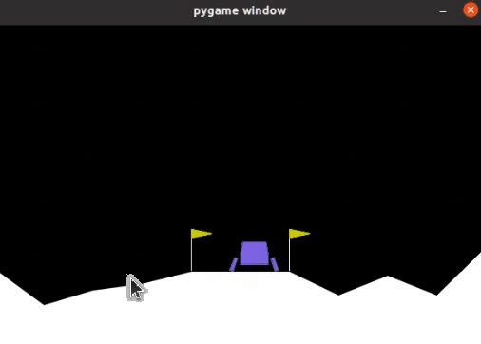
Main Focus
The Symphony algorithm was developed to solve one of the problems of Reinforcement Learning - the need for numerous experiments. It was necessary to bring the algorithm to a level close to the presence of a ready-made mathematical model, so as not to wait for 10k episodes and millions of steps.
The advantage of the Symphony algorithm is that the agent learns at each microstep or transition. It does not need to wait for the end of an episode or episodes to improve the current state. But the price for this in such algorithms is the possible unstable state of the agent due to learning during action. This drawback was almost eliminated in the Symphony S2 algorithm.

Slide 4
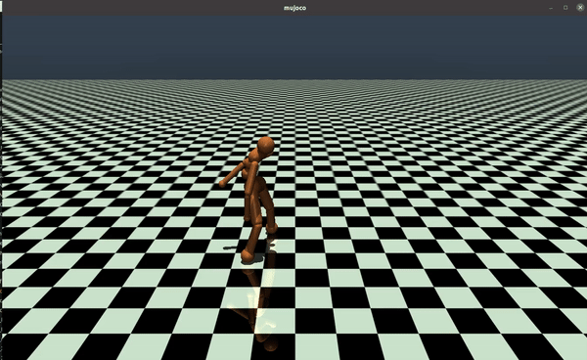
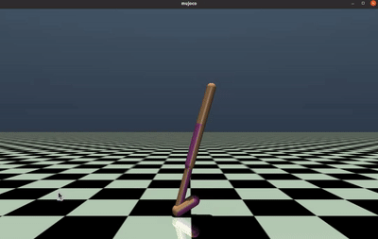
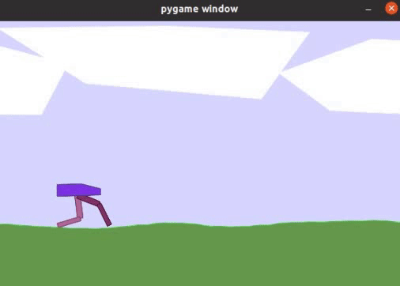
Symphony ver.1.0: Need for Speed
When speed is the main criterion, the model focuses on speed rather than smoothness

Slide 5

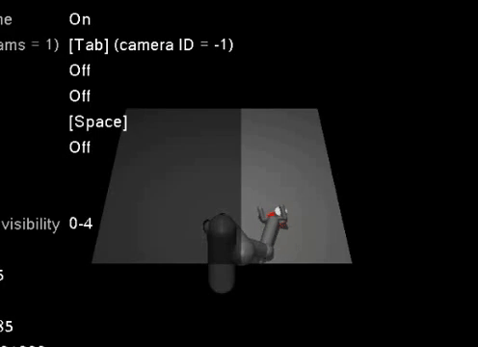
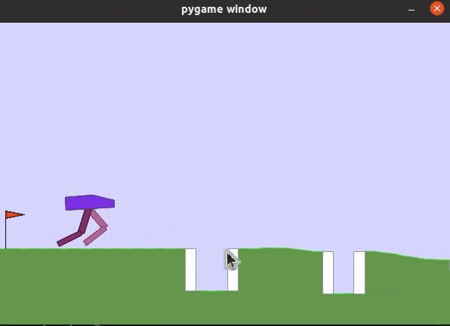
Symphony S2: Need for Speed and Plasticity
We managed to achieve plasticity without a person-in-the middle of training. And speed somewhat retained

Slide 6
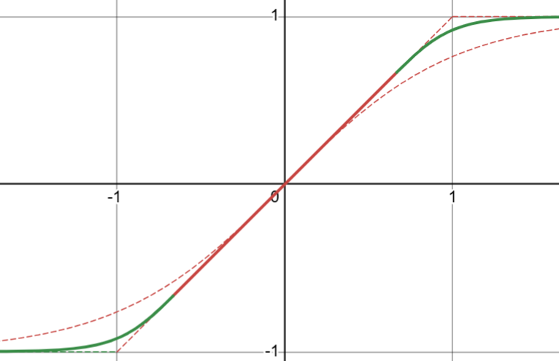
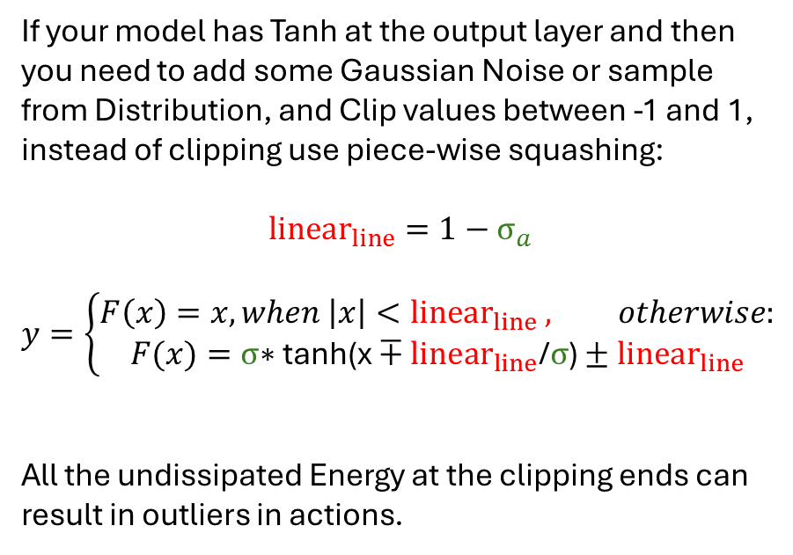
Note before we start with underlying theory: use Clipping and Clamping with caution
If your model has Tanh at the output layer and then you need to add some Gaussian Noise or sample from Distribution, and Clip values between -1 and 1, instead of clipping use piece-wise squashing:
$${linear}_{line}=1−σ_{a}$$
$$y=\left\{\begin{aligned}F\left(x\right)=x, when \left|x\right|<{linear}_{line} , otherwise: \\ F(x)=σ\text{∗ }\text{tanh}\text{(}\text{x}∓{linear}_{line}\text{/}σ\text{)}±{linear}_{line}\end{aligned}\right.$$
All the undissipated Energy at the clipping ends can result in outliers in actions.

Slide 7
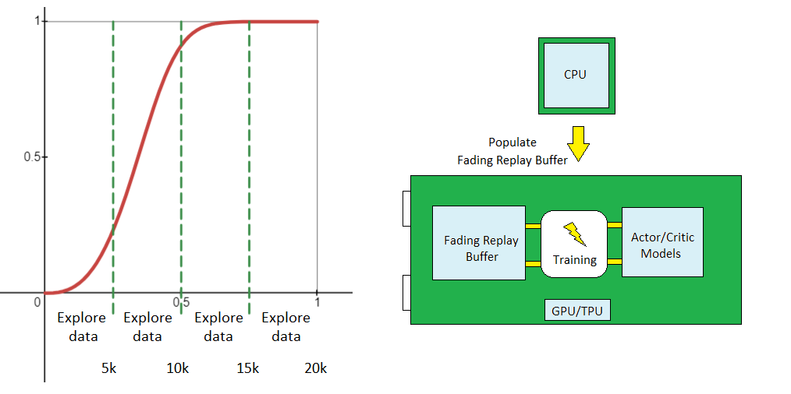
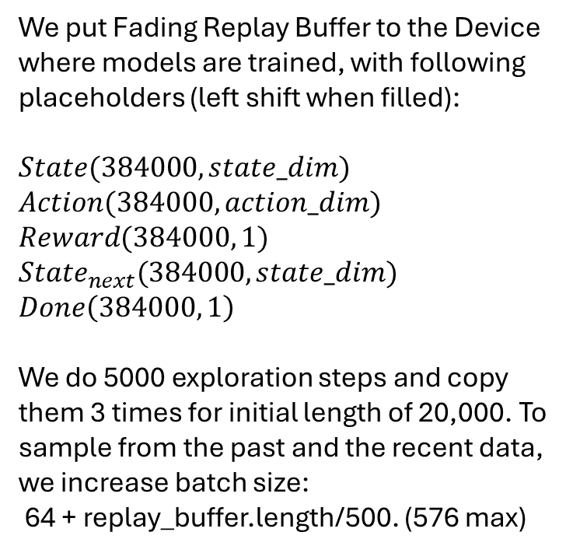
Replay Buffer length: 384,000
We do not calculate priorities based on gradients, but based on current normalized indexes:
$$w=\tanh\left(10 {indexes}^{2.7}\right);p=w/sum(w)$$
We put Fading Replay Buffer to the Device where models are trained, with following placeholders (left shift when filled):
$State(384000, state_dim)$
$Action(384000, action_dim)$
$Reward(384000, 1)$
${State}_{next}(384000, state_dim)$
$Done\left(384000, 1\right)$
We do 5000 exploration steps and copy them 3 times for initial length of 20,000. To sample from the past and the recent data, we increase batch size:
64 + replay_buffer.length/500. (576 max)

Slide 8
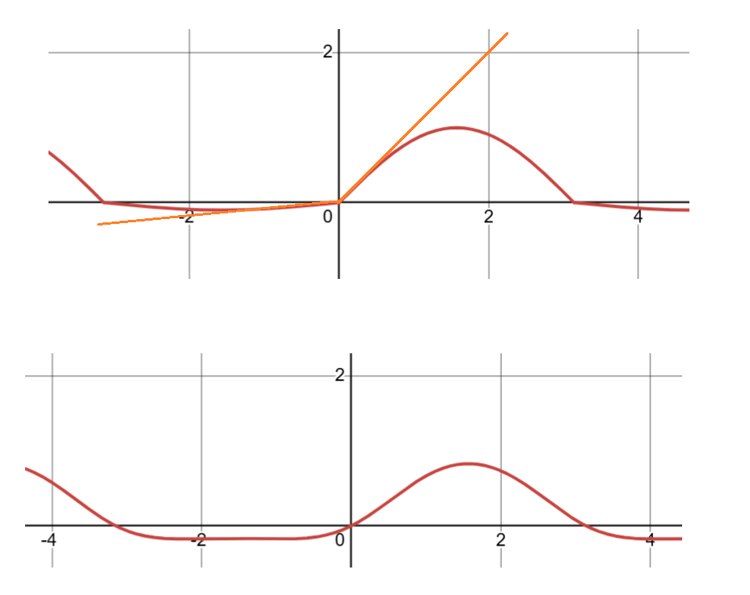
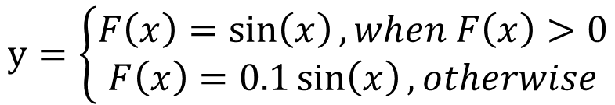
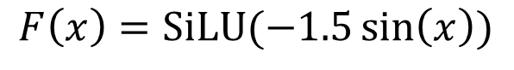
Human move in Burst of Harmonics ReLU can be one of the derivatives of ReSine
Symphony Ver 1.0
$$y=\left\{\begin{aligned}F\left(x\right)=\sin\left(x\right), when F\left(x\right)>0 \\ F\left(x\right)=0.1\sin\left(x\right), otherwise\end{aligned}\right.$$
Symphony S2
$$F\left(x\right)=SiLU(−1.5\sin\left(x\right))$$
________________
SiLU = x * sigmoid(w x)

Slide 9
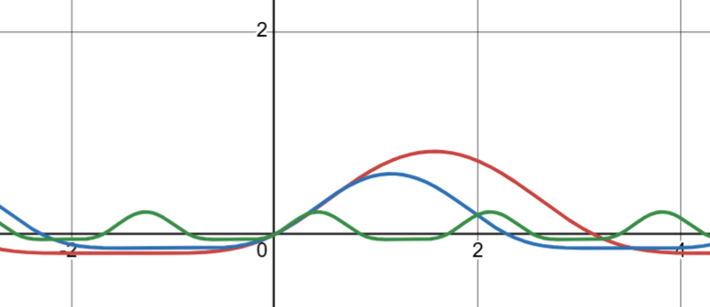
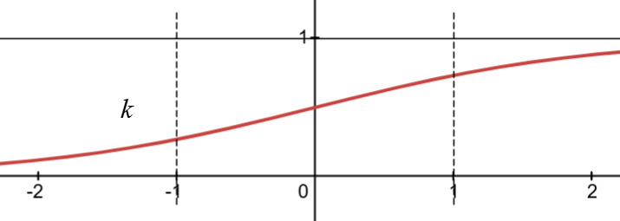
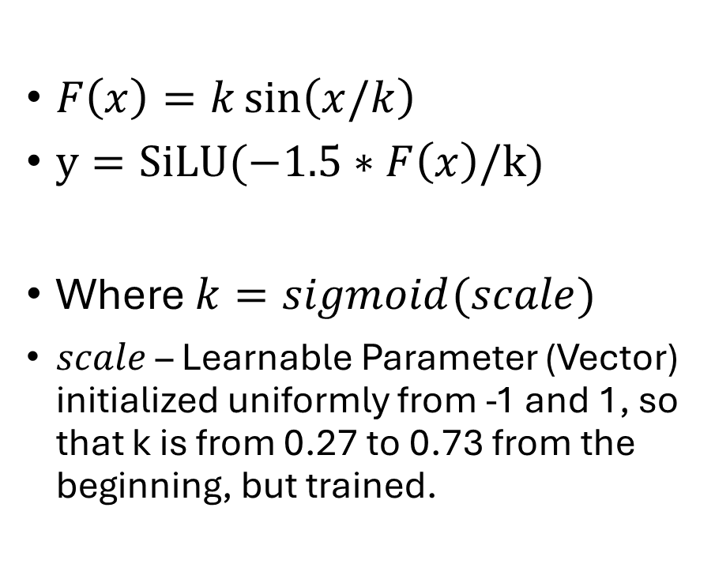
Make Scale Learnable
Symphony S2 final ed.:
$F\left(x\right)=k\sin\left(x/k\right)$
$y=SiLU(−1.5∗F\left(x\right)/k)$
Where $k=sigmoid(scale)$
$scale$ – Learnable Parameter (Vector) initialized uniformly from -1 and 1, so that k is from 0.27 to 0.73 from the beginning, but trained.

Slide 10
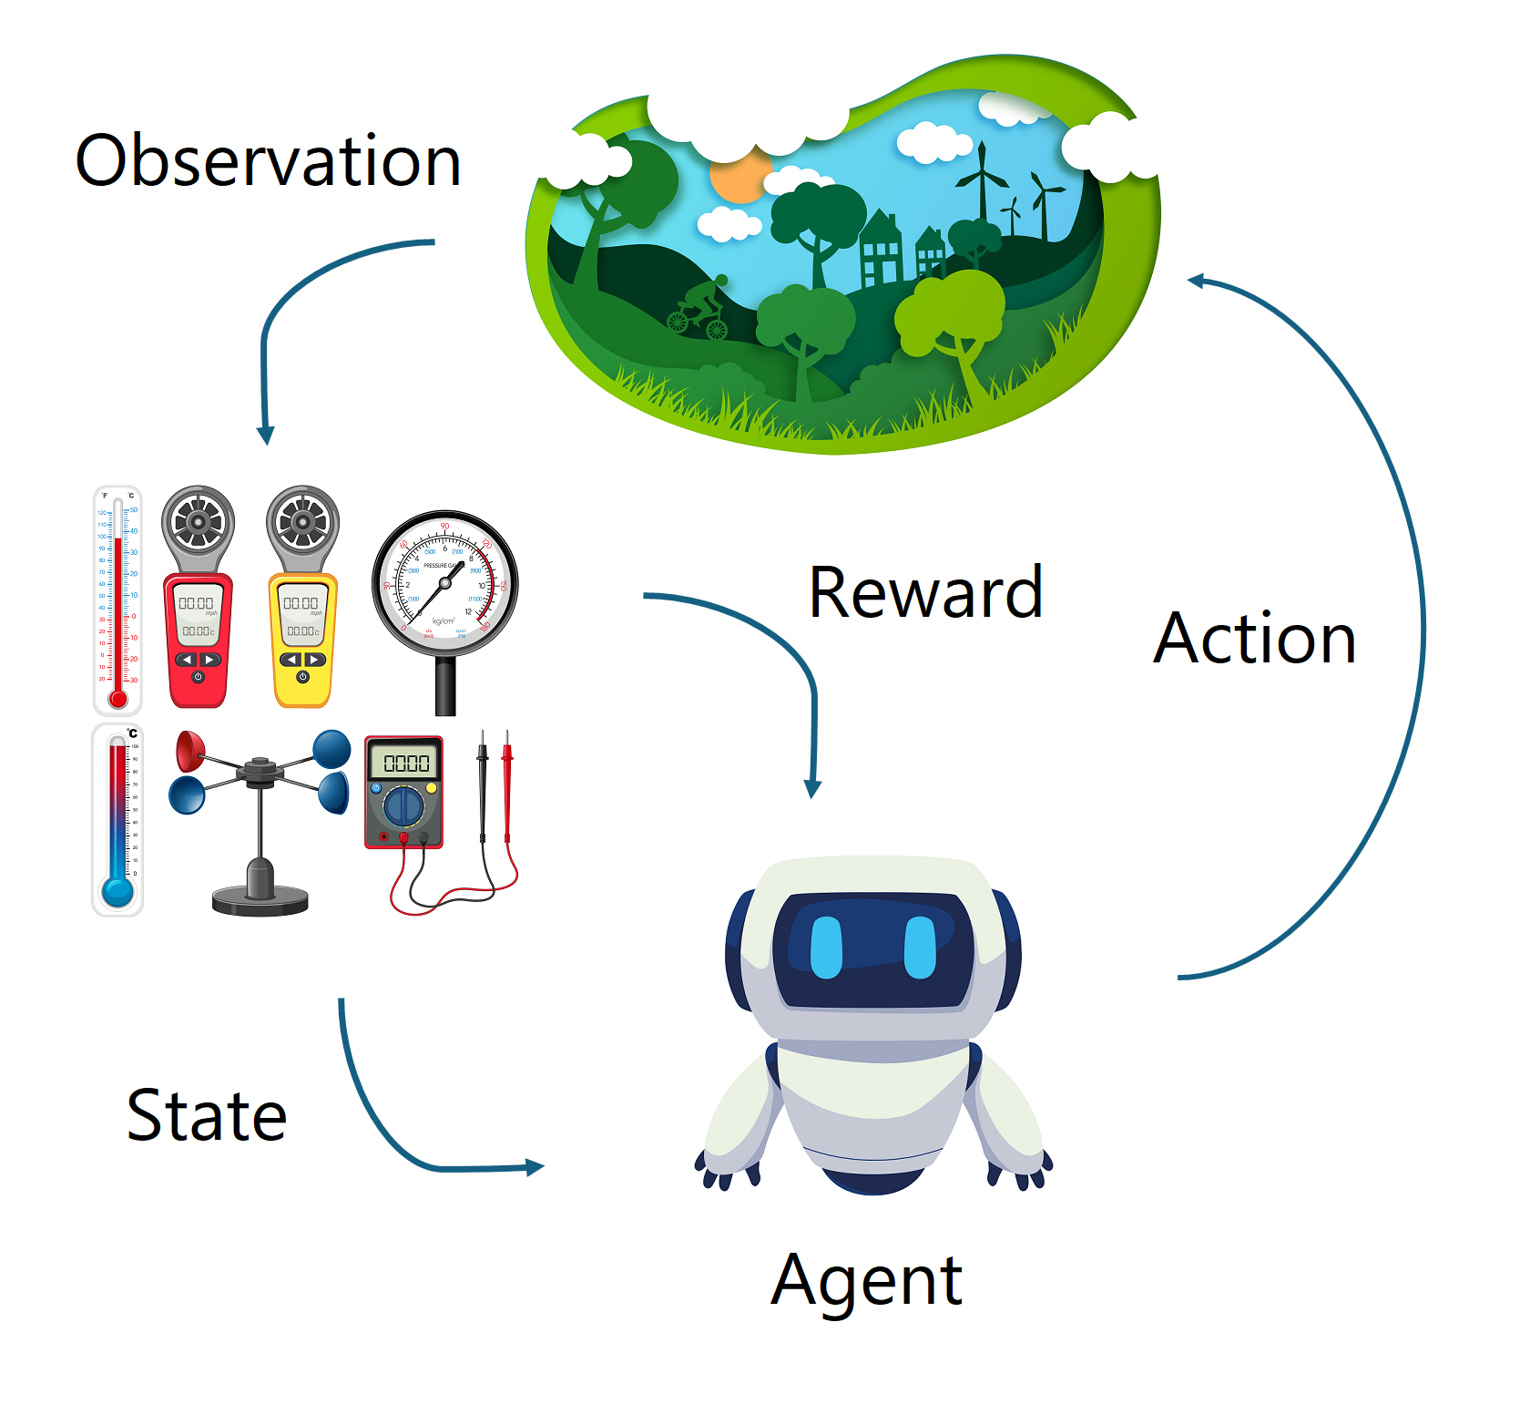
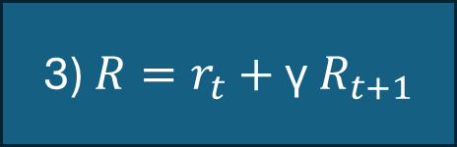
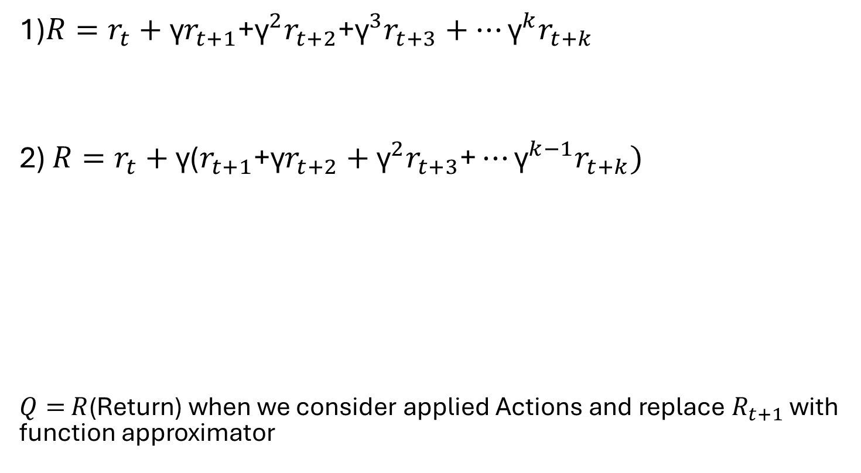
Temporal Difference Richard Bellman’s Equation
1)$R=r_{t}+\text{γ}r_{t+1}$+${\text{γ}}^{2}r_{t+2}$+${\text{γ}}^{3}r_{t+3}+…{\text{γ}}^{k}r_{t+k}$
2) $R=r_{t}+\text{γ}\text{(}r_{t+1}\text{+}\text{γ}r_{t+2}+{\text{γ}}^{2}r_{t+3}\text{+}…{\text{γ}}^{k−1}r_{t+k})$
$Q=$ $R$(Return) when we consider applied Actions and replace $R_{t+1}$ with function approximator
3) $R=r_{t}+$ $\text{γ} R_{t+1}$

Slide 11
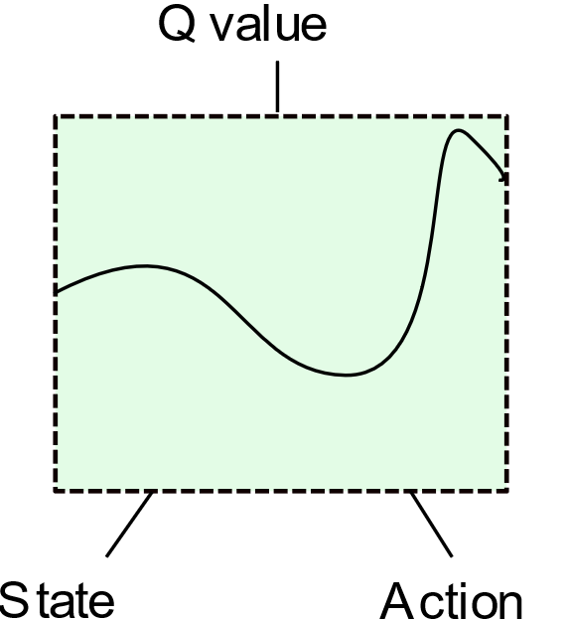
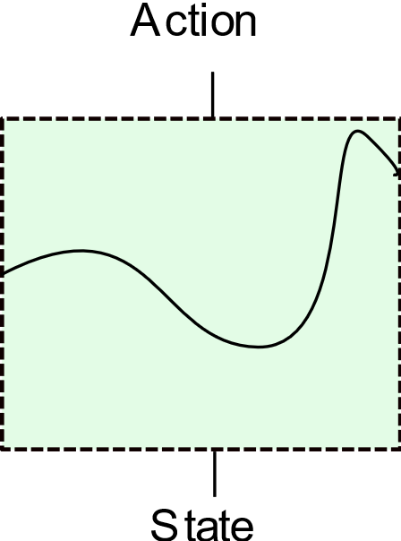
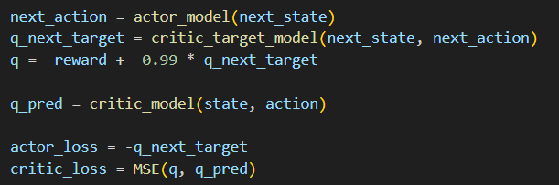
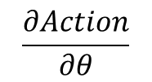
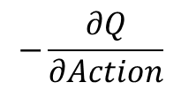
DDPGII: Actor-Critic Seamless update
We can use next_state and next_action to update Actor in one go by:
loss = – q_next_target.
It was rarely used before as target Critic is much slower.
But with higher update-to-data ratio (namely, 5) we can utilize target Critic and next state and next action to update Actor.
Critic
$$−\frac{∂Q}{∂Action}$$
$$\frac{∂Action}{∂θ}$$
Pseudocode:
Actor

Slide 12
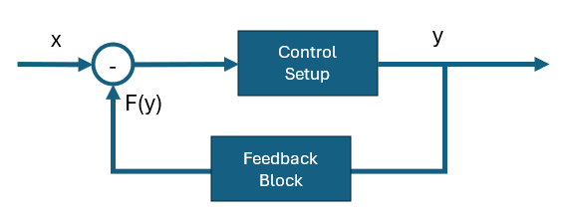
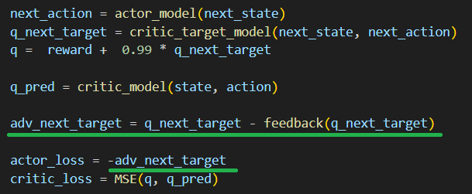
Symphony ver 1.0 Temporal Advantage = Negative Feedback
If we have q_next_target, why to throw it away? We can store it and improve Advantage in Time. It is also a Negative Feedback from the Control Theory. We can use all the Theory behind it (e.g. Kalman Filter), I used Exponential Weighted Average for 10 previous steps.
Pseudocode:

Slide 13
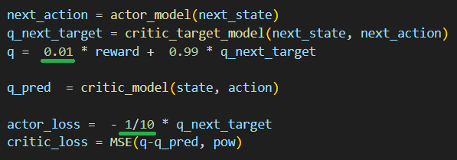
Q value brute normalization, policy scaling
Temporal Advantage can be considered a manual workaround. Comparable performance was achieved when we normalized Q value by brute force multiplying the reward by 0.01 in Temporal Difference and added 1/10 factor for the Actor loss. This makes original DDPG like learning rates, where Actor’s learning rate is 10 times smaller than of Critic’s.
Pseudocode:
Because of internal Harmonics, Symphony is an explorer by its architecture. To explore and, consequently, make a lot of failures in the beginning is a good experience gathering practice.
However, for practical robotics systems, it can cause a malfunction. Action range should be limited initially, and only increased slowly when short distance experience is gathered. We decided to focus on that instead when removed Temporal Advantage.

Slide 14
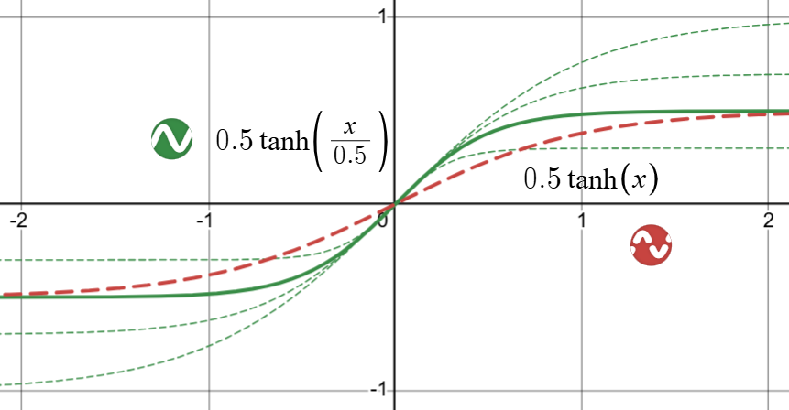
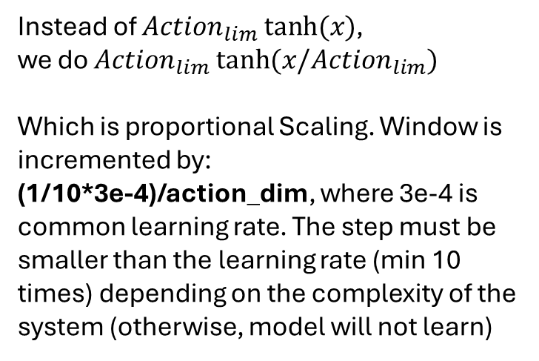
DDPGII: epsilon working as Action window
Action_max is a maximum action that Environment sends to us when we initialize it and the Agent. It is a constant.
Action_lim is a limiting factor that is: window * Action_max.
Window can be considered as epsilon working backward, e.g. from 0.333 to 1.0 with small step increase at each gradient update.
Instead of ${Action}_{lim} tanh⁡(x)$,
we do ${Action}_{lim} tanh⁡(x/{Action}_{lim})$
Which is proportional Scaling. Window is incremented by:
(1/10*3e-4)/action_dim, where 3e-4 is common learning rate. The step must be smaller than the learning rate (min 10 times) depending on the complexity of the system (otherwise, model will not learn)

Slide 15
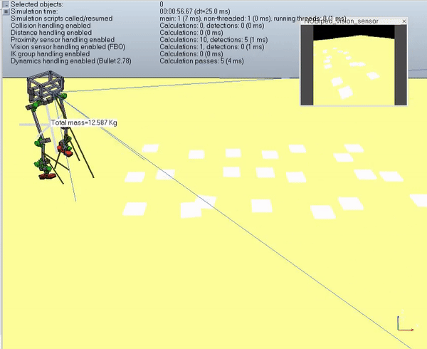
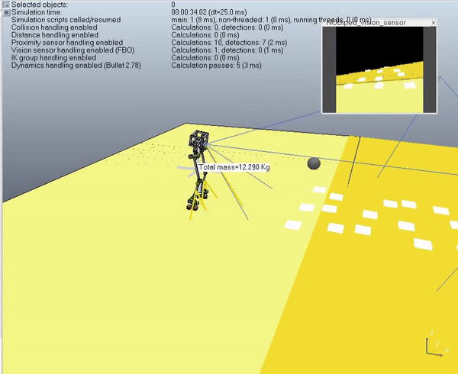
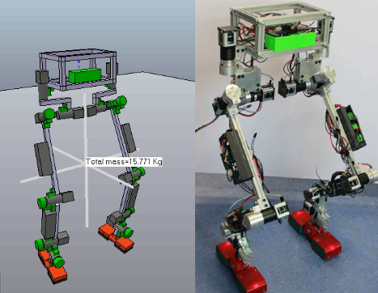
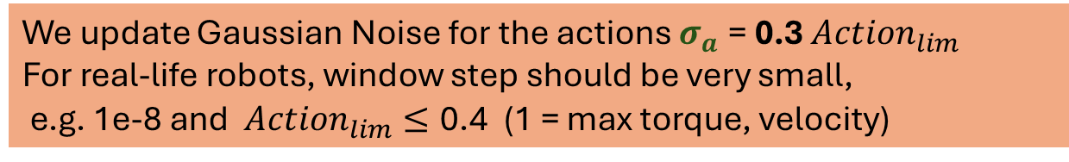
Symphony S2 applied to Robotics, 3rd objective
We update Gaussian Noise for the actions $σ_{a} \text{=} \text{0.3} {Action}_{lim}$
For real-life robots, window step should be very small,
e.g. 1e-8 and ${Action}_{lim}≤\text{0.4}$ (1 = max torque, velocity)

Slide 16
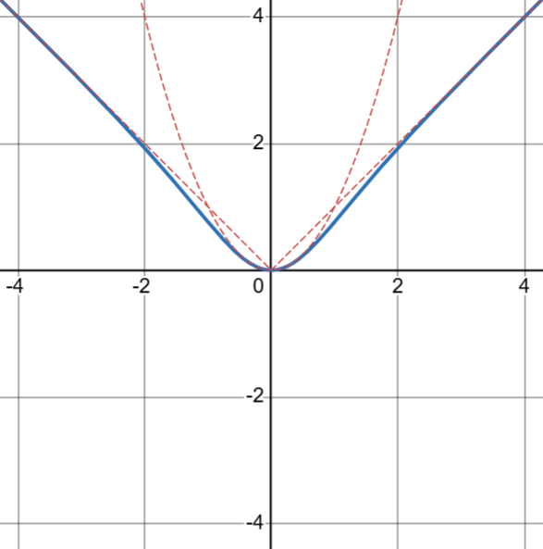
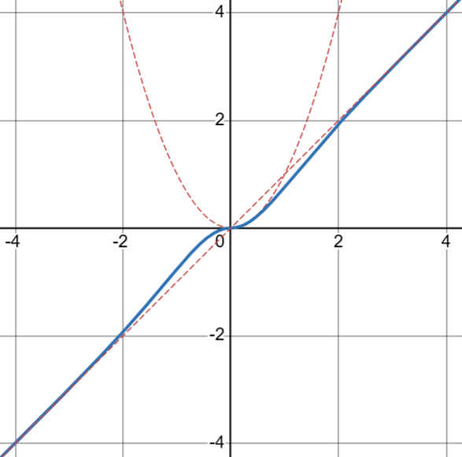
Loss Functions: ReHAE and ReHSE
Rectified Huber Symmetric Error
x tanh(x)
When retaining sign is NOT important (MSE, MAE alternative)
Rectified Huber Asymmetric Error
|x| tanh(x)
When retaining sign is important (Advantage)

Slide 17
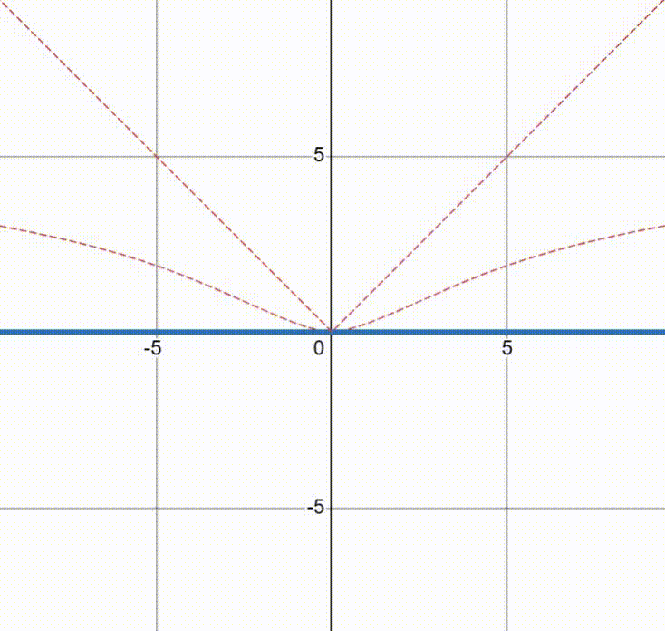
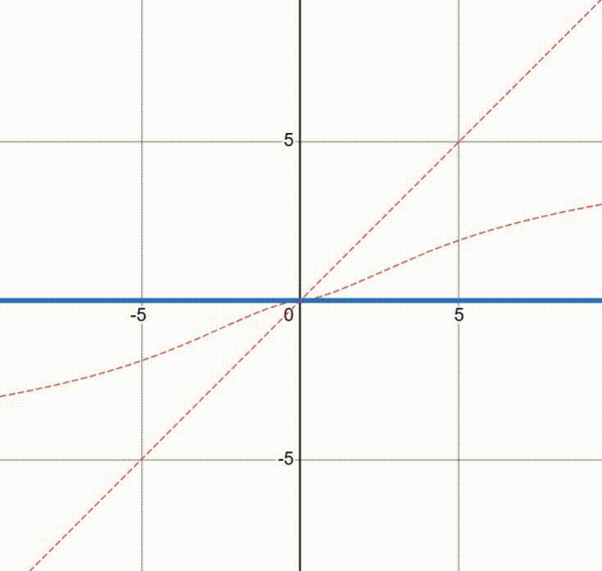
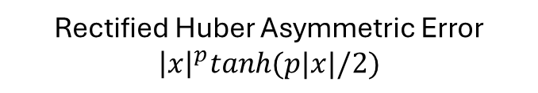
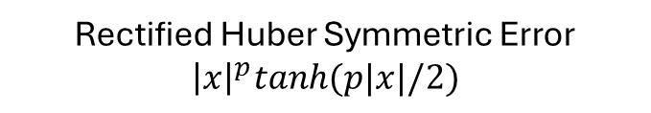
Improved ReHSE/ReHAE: “Blossoming Flowers”
To eliminate overfitting and overestimation problems, we start with very low value for the loss functions
Rectified Huber Asymmetric Error
$${\left|x\right|}^{p}tanh(p|x|/2)$$
Rectified Huber Symmetric Error
$${\left|x\right|}^{p}tanh(p|x|/2)$$
p=Buffer.length/Buffer.capacity.
But in practice, we use p=1/2 * Buffer.length/Buffer.capacity and do not rise beyond this this level

Slide 18
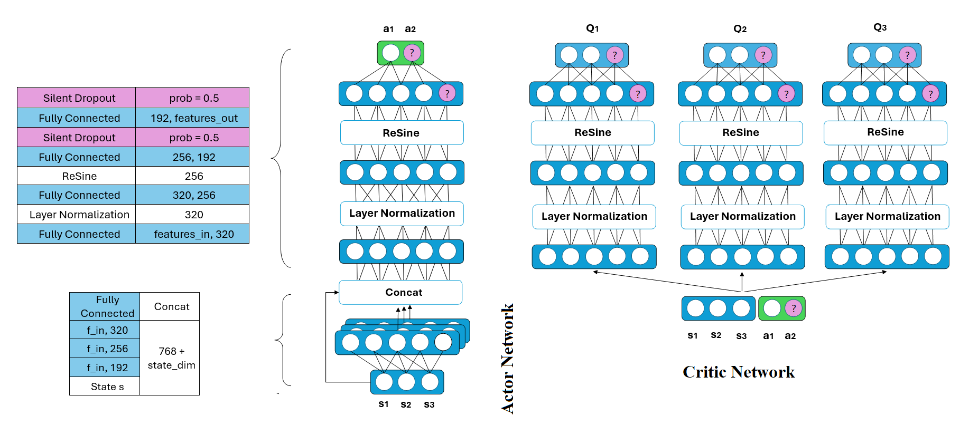
DDPGII Architecture. Each Q network outputs 320 nodes we concatenate them and take mean value as target Critic’s prediction

Slide 19
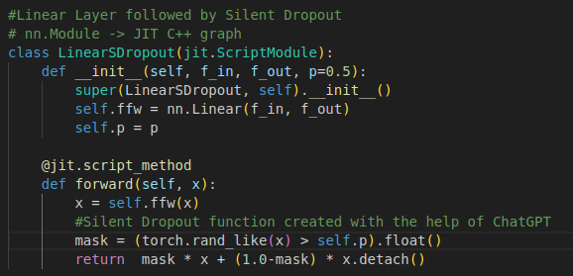
Silent Dropout at the latent and output layers
Original Dropout turns some nodes to 0, which shifts output distribution towards zero.
Silent Dropout replaces zeroed nodes with original output values which were detached from the gradient computation.
Thus, we still maintain some level of randomness as we do not update gradient for some nodes. But most importantly distribution is not distorted. It can be embedded into Linear Layer, Implementation in PyTorch (50% dropout).
Silent Dropout parodies Ensemble Learning. It also helps against over-fitting. Reset Algorithm (SR-SAC) usually resets the last 2 layers. We have other regularization techniques like Normalization and ReSine activation function, while Silent Dropout regularize/generalize the last 2 layers without distortion.

Slide 20
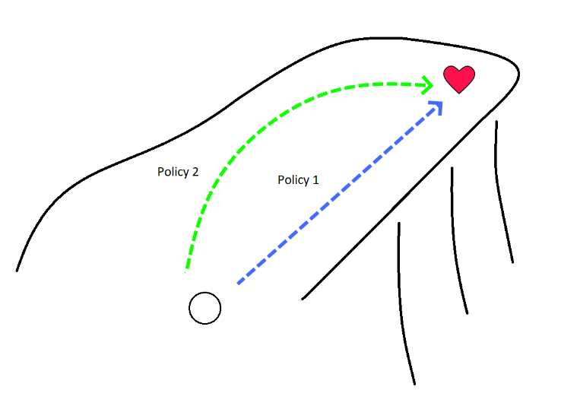
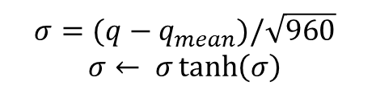
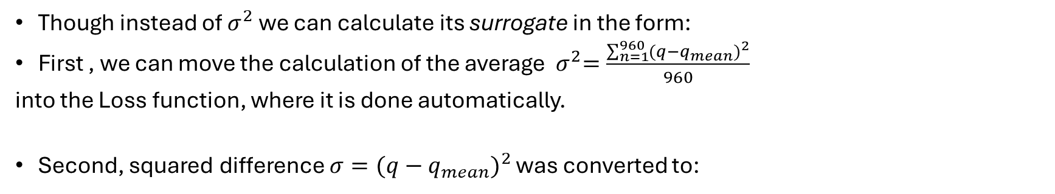
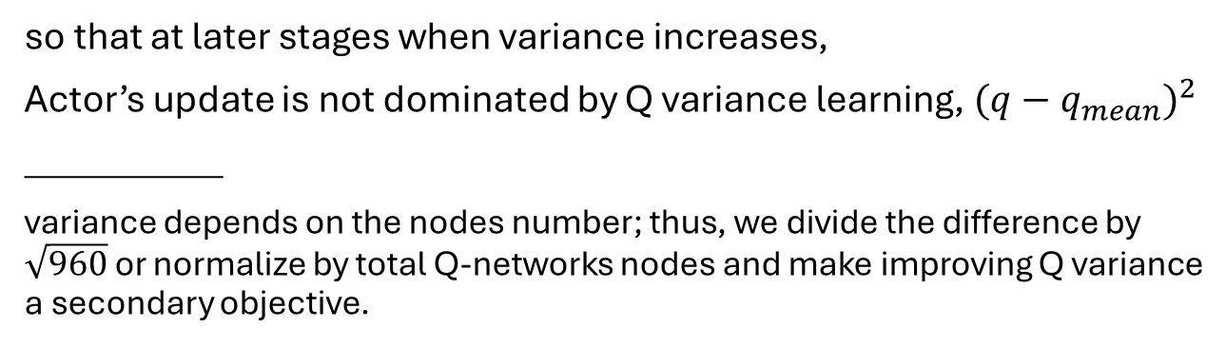
We can improve Q variance without much effort
Though instead of $σ^{2}$ we can calculate its surrogate in the form:
First , we can move the calculation of the average ${ σ}^{2}=\frac{\sum_{n=1}^{960}{{(q−q_{mean})}^{2}}}{960}$
into the Loss function, where it is done automatically.
Second, squared difference $σ={(q−q_{mean})}^{2}$ was converted to:
$$σ=(q−q_{mean})/\sqrt{960}$$
$$σ← σ\tanh\left(σ\right)$$
so that at later stages when variance increases,
Actor’s update is not dominated by Q variance learning, ${(q−q_{mean})}^{2}$
___________
variance depends on the nodes number; thus, we divide the difference by $\sqrt{960}$ or normalize by total Q-networks nodes and make improving Q variance a secondary objective.

Slide 21
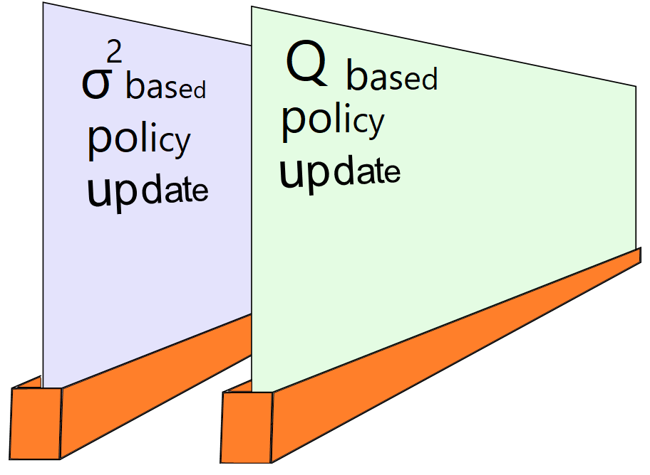
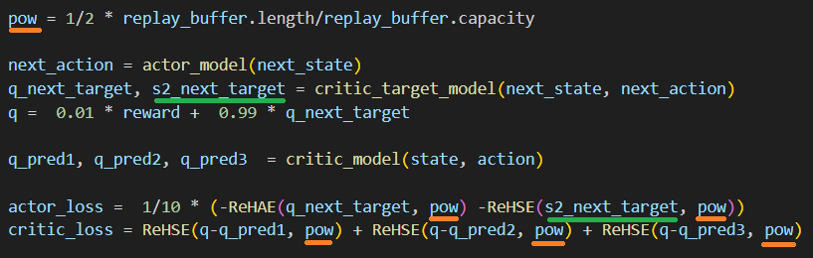

2 cartridge working in parallel: target Q based policy update and $σ^{2}$ based policy update
DDPGII: Final Pseudocode
Pseudocode:
Improving Q variance can degrade speed of common learning,
but can bring balanced Q learning at the end (Q generalization)

Slide 22
Thank you. Credits:
No other God died for our sins. “Punishment for sins is Death” Cross=Love of God. Jesus Christ is my King.
Environment Image by Freepik
Measuring Devices Image by brgfx
Robot Image by stockgiu
Gamepad by racool-studio

Slide 23
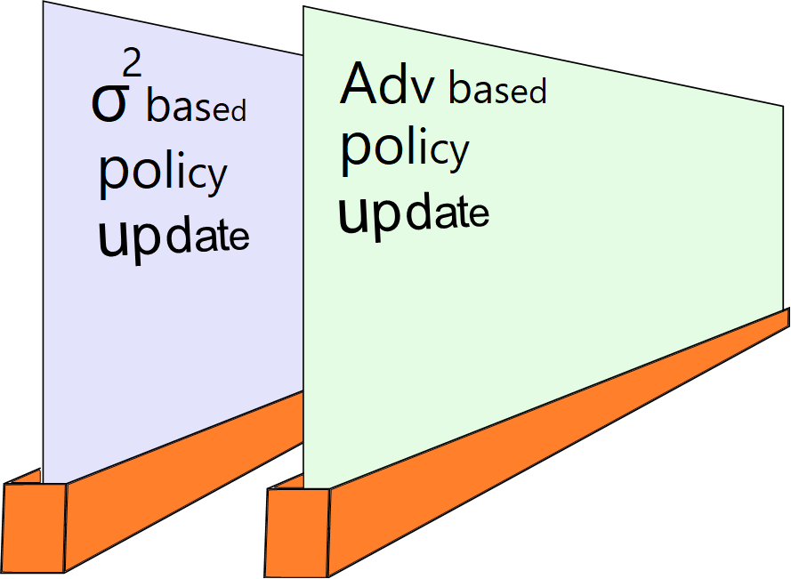
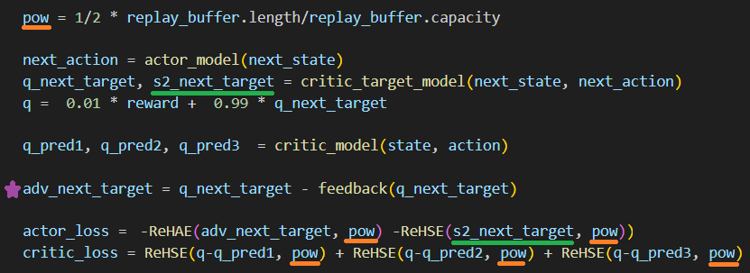
DDPGII(Symphony S2): Final Pseudocode
Pseudocode:
We returned Temporal Advantage back, left 0.01 reward multiplier, but removed 1/10 factor for the Actor Loss.

